Slide 1
Public Goods
Steven Suranovic
George Washington University

Slide 2
Market Imperfections or Market Failures
Any deviation from the assumptions of perfect competition
Examples include …
Monopoly/Oligopoly
Monopsony/Oligopsony
Public Goods
Externalities
Common Resources
Imperfect Information
Unemployment
Government policies

Slide 3
Public Goods
A public good is both non-rival and non-excludable in consumption.
Rivalry vs Non-Rivalry
A Rival good or service – when one person’s use prevents another from using it
A Non-rival good or service – when one person’s use does not prevent another person from using it simultaneously
Rival Examples
Food, Clothing, Housing, congested roads
Non-Rival Examples
Lighthouse service, uncongested roads

Slide 4
Public Goods
A public good is both non-rival and non-excludable in consumption.
Excludability vs. Non-Excludability
An excludable good or service – when it is possible to restrict access or use
A Non-excludable good or service – when it is not possible to restrict access or use
Excludable Examples
Food, Clothing, Housing, toll roads
Non-Excludable Examples
Lighthouse service, freeways

Slide 5
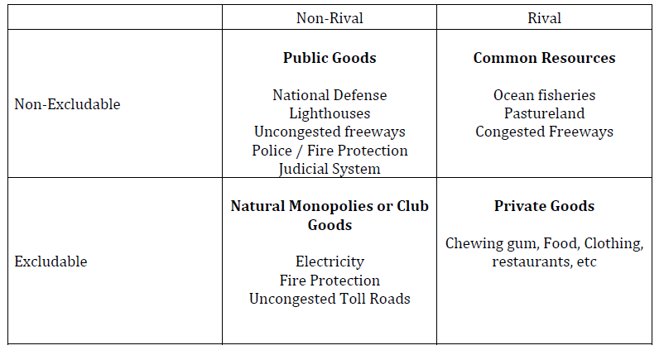

Slide 6
Public Good Provision
Public good provision is difficult in a free market because firms find it difficult to solicit payment from consumers who can easily “free ride.”
Free riding occurs when someone receives a benefit without having paid for it
Taxi ride from airport with a friend on company expense
Watching neighbor’s backyard fireworks show
Wikipedia
Listening to National Public Radio without contributing

Slide 7
Public Good Provision
It is the non-rival and non-excludable nature of a public good that makes free-riding easier
Private firms would under-supply a public good because of free riding
However, if government provides public goods, then they can force taxpayers to pay and eliminate the free rider problem
Government provision of public goods can (not will) raise supply to the optimal level
Thus, government provision of a public good can (not will) raise market welfare, i.e., improve economic efficiency.

Slide 8
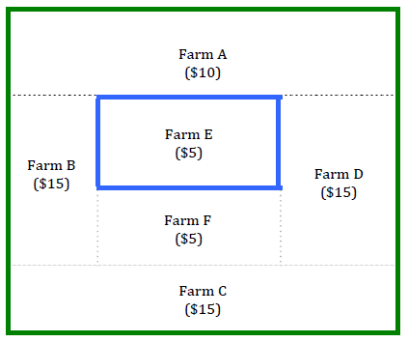
Public Good Provision Example
Suppose there are 6 farms who sometimes have their crops stolen by bandits
If they build a wall, it will prevent the theft
Let the values in (.) represent the $ value willingness to pay for a wall for each farm

Slide 9
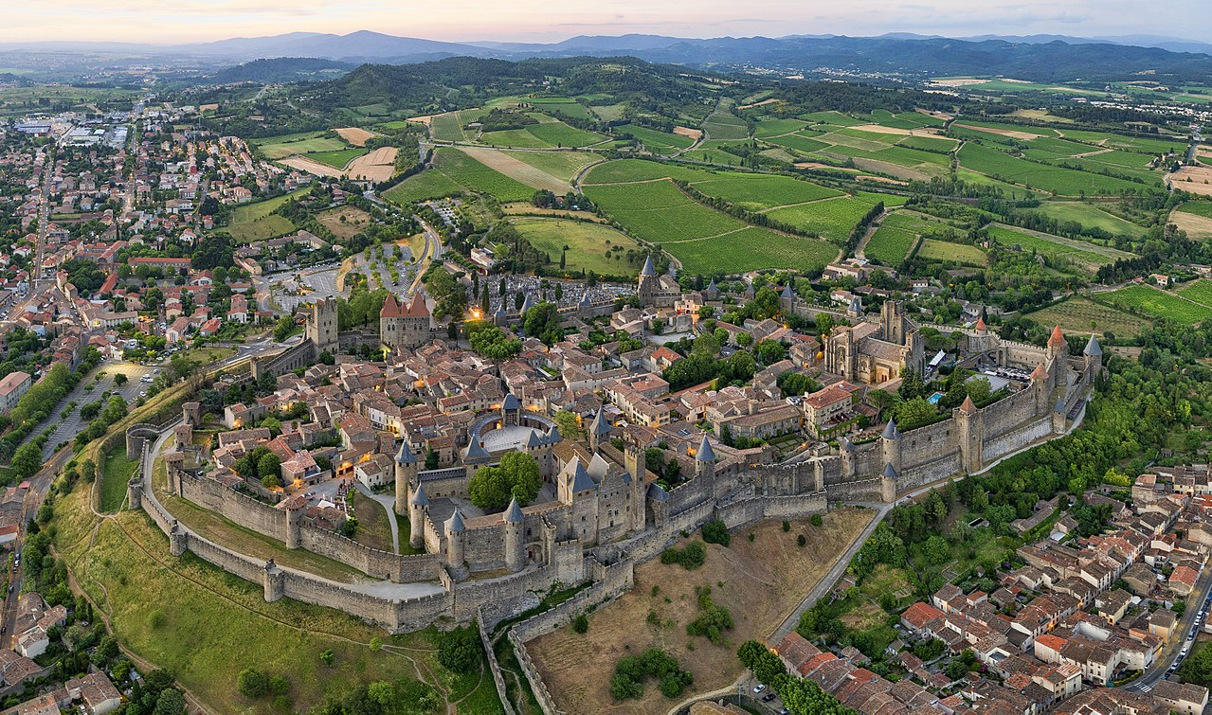
Public Good Provision Example
Protection from Roving Bandits (Mancur Olson)
Small communities need protection from bandits who “rape, pillage, and plunder”
See movies: Seven Samurai or Magnificent Seven
Carcassonne, France

Slide 10
Public Good Provision Example
Suppose an individual wall (blue), protecting one farm costs $20 to build
Suppose a large external wall (green) costs $50 to build
Next consider methods to improve economic efficiency

Slide 11
Public Good Provision Example
Individual Walls
Suppose each farm builds their own individual wall
Total benefits = (10 + 15 + ….) = $65
Total cost = 6 x $20 = $120
Profit = 65 – 120 = - $55
Won’t be chosen because each farm loses and economic efficiency falls

Slide 12
Public Good Provision Example
Collective Action 1
One farmer solicits contributions from the farmers
Suppose Farms A-D contribute their maximum minus $1
Farms E-F free ride, they refuse to pay anything

Slide 13
Public Good Provision Example
Collective Action Continued
Total Payment = (3x14) + 9 = $51
Net Benefit for A-D = $4
Net Benefit for E-F = $10
Suppose $1 extra payment used for a post-construction party with E-F not invited!
Economically efficient because NB > 0, but will not be considered completely just or fair

Slide 14
Public Good Provision Example
Benevolent Government
A government implements a $8.33 per farm tax (8.33 x 6 = $50) to finance a green wall
Net benefits = 65 – 50 = $15
Farms A-D happy with government
Farms E-F not happy with government
In a democracy, farmers would vote for this tax

Slide 15
Public Good Provision Example
Corrupt Government
A government implements a $20 per farm tax (20 x 6 = $120) to finance a green wall
Uses the extra $70 for government officials’ perks
Net farm benefits = 65 – 120 = - $55
All Farms unhappy
Unjust and unfair – No farms would vote for this

Slide 16
Government: Good, Bad or Unnecessary
These examples show how government provision of public goods can solve the free rider problem and improve economic efficiency (good)
Private collective action provision might be possible but could create injustices because some may free ride (unnecessary)
However, government must be constrained in its use of power. A corrupt government can overtax and transfer money for the benefit of the government officials themselves. (bad)
Note that the corrupt government needs the wall too so its citizens will produce and retain more for them to confiscate

Slide 17
Government: Good, Bad or Unnecessary?
Consider early human societies 5-10,000 years ago. Farming communities needed protection against internal community theft and external bandits.
What if Roving Bandits decide to settle down and become Stationary Bandits (early government)? (Mancur Olson)
Can control population with ability and willingness to use superior force
Can offer internal and external protections
Must leave citizens free enough to produce a taxable surplus
Internal law and order important for economic efficiency
Tribute (i.e. taxes) paid to the rulers who become kings, tyrants, or gods

Slide 18
Government: Good, Bad or Unnecessary?
How to prevent government tyranny?
Advent of democracy offers one method
Leaders are accountable to the people
Leaders reflect the will of the people
Modern democracy arose in response to oppression
Subsequent freedoms may be responsible for the Great Enrichment – the dramatic increase in living standards with industrialization

Slide 19
Government: Good, Bad or Unnecessary?
Purpose of a democratic government
→ Provision of public goods including,
internal police, (maintain internal order)
standing army to protect against foreign threats,
judicial system to adjudicate disputes,
Provision of roads and parks,
Enforcement of laws against violence, deception, etc.

Slide 20
Government: Good, Bad or Unnecessary?
What is the right amount of government?
Too little government → public goods insufficiently supplied
Too much government → potential tyranny
Loss of individual freedoms, exploitation of citizens by a wealthy elite
It is reasonable to debate the right level of government
But also important is what actions the government takes
Promote the General interests or the Special Interests?
Listen to all equally or listen more to wealthy?
Promote monopoly, or anti-monopoly?

Slide 21
Ethics in the Provision of National Security
How to induce participation in an army?
Pure self-interest may not produce any volunteers
Patriotism / Loyalty: inspire duty to country
Hierarchy acceptance: follow the orders of superiors
Courage: courageous behavior inspires a willingness to take risk for the betterment of the group (even risking one’s life)
These traits are promoted in families and businesses too

Slide 22
Ethics in the Provision of National Security
Patriotism, Hierarchy and Courage are also traits that are beneficial to a stationary bandit, a tyrant, or a leader determined to conquer others (Hitler, Alexander the Great, Genghis Khan, etc.)
These ethical principles should be subordinate (or secondary) to earlier ones; namely the avoidance of theft, violence and deception, and the promotion of individual market freedom
Too often loyalty is touted as the highest ethic … why?

Slide 23
Ethics in the Provision of National Security
Patriotism, Hierarchy and Courage can facilitate the production of the public good, national security
Patriotism, Hierarchy and Courage is also promoted by tyrants to facilitate theft/domination over others
Loyalty and Hierarchy can facilitate the operation of business and improve organizational efficiency
Loyalty and Hierarchy can also facilitate the promotion of bad business behavior involving theft, deception, or monopolization

